Slide 1
Application Migration and Modernization Hackathon

Slide 2

Abstract and learning objectives
Abstract
Modernize legacy on-premises applications and infrastructure by leveraging several cloud services, while adding a mix of Azure services.
Hackathon objectives
Use Azure
Think about solving the problem (no IT Learning Karaoke )
Leverage Azure Services to Modernize an Application, not just a lift and shift

Slide 3

But before we begin….

Slide 4
Challenge #0 Get your “on premise” environment ready….
Login to Azure….
Open your browser to https://aka.ms/appmodernization
Press the Deploy to Azure Button
Make sure to create a new Resource Group for your Team!!
Accept the other defaults and agree to “purchase”
IT will take 30 mins or so to set up the environment
Notes:
If you have a Mac… great! You’re already a step ahead.
If not, get your Windows box loaded up with all the tools that work well in the OSS world!

Slide 5
The Journey to the Cloud
Migrate
Application Modernization
SaaS
Rehost
Refactor
Rearchitect
Rebuild
Replace
On-Premises
Infrastructure Platform
IaaS
Infrastructure Platform
“lift & shift”
Containers
Managed Container Platform
PaaS/Serverless
Application Platform

Slide 6

Challenge Scenario
Parts Unlimited is in the auto part business
The sell via a brick and mortar store but have invested in a small e-commerce presence to augment the stores
They are trying to cope with being overloaded due to faster-than-expected growth
They want to begin their journey to the cloud

Slide 7
Challenge Goals
Migrate the Website to the cloud leveraging PaaS services
Enhance application stability with logging, monitoring and alerting
Add automation in the cloud to support CI/CD processes
Impove application responsiveness with auto scaling, caching and a CDN
Enahnce customer access to products with search
Begin to decouple the web app with Serverless Functions and API management to expose services to partners

Slide 8
CEO Ask….
“We would like to make sure our database isn’t overtaxed, have the ability of updating the website automatically when we check in, have the application scale up/down when needed, have a fast response time to improve customer experience”
“Can you help us do this?”

Slide 9
Challenges Overview
Create a lab IaaS environment
Perform migration to PaaS
Implement DevOps CI/CD & App Insights
Optimize & Protect Web App/Database
Breaking out code out into serverless
Monetize & manage your data and API services

Slide 10

Hack Ground Rules
Work together in teams (4-6 people)
Finish each challenge before moving on
There are multiple options to solving each problem
There are more challenges than time available
Ask questions, Ask the Proctors ( we won’t give out answers but hints…)

Slide 11
Application Services in the Cloud

Slide 12

Azure App Service
Enterprise-grade apps
Fully managed platform
High productivity development
Global data center footprint
Hybrid support
Built-in auto scale and load balancing
High availability with auto-patching
.NET, Java, PHP, Node,
Ruby, and Python
Staging and deployment
AAD integrated
Secure + compliant
Reduced operations costs
Backup and recovery
Testing in production
App gallery marketplace

Slide 13





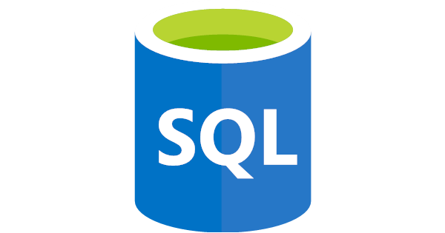
Benefits of moving to App Service
Get started in just a few clicks with the Azure App Service Migration Assistant
Get out of the data center business
High availability and resilience of the Azure PaaS platform
Easily deploy website monitoring to track website health and get rich diagnostics, without changing any code
Deployment slots for development and staging environments, and testing of multiple site designs
Load balancing and DDOS protection
Traffic management to direct users to the closest geographic deployment
Reduce TCO by ~35% on average
On-Premises
PaaS Cloud
Relational Database
Using:
Servers or VMs on-premises
SQL Server, Oracle, MySQL, etc.
Using:
Azure App Service Web Apps
Notes:
Running these apps in a data center by yourself
Always been challenging to deploy your asp.net apps – speed to deployment is what you will get
High scale and high availability has always been a problem – azure has a ton of options
App Service and Containers – reduce your TCO by having more density and better utilization
^ those are for all 3 options
VM only:
You’re getting out of the data center; keep high availability of the hardware
Easily take advantage of things like Azure Montoring, so that you know what’s going on with your application
Pain: they deploy a website and have no way to monitor it? They have to be reactive; they don’t know ahead of time of their apps are healthy, until end users file tickets
You can get richer diagnostics without changing a single line of code
Most customers don’t have the ability to build a solution for this on their own
Agility: #1
Time to deploy
Time to patch
Updates – OS and application, security updates, etc.
Speed to deployment – deployment often takes a long time – can take hours to days; instead can take minutes – but this might not apply for VMs?
Patch service now for VMs? Paul doesn’t know how this is going for customers though
For VMs only: for dependencies - you will have a template for your VM, rather than a large Word doc.
If you implement VSTS, then VSTS can publish straight to your VM
Perhaps use the first three on the Modernization slide, and make a separate slide for TCO that reps can choose to use or not
Compelling events:
If you have apps that are coming up to end of life, the fear of going out of support
If you go to the cloud, you mitigate that risk because Microsoft will always provide support
But with VMs, you can still have that inflection point where you need to move to a more modern VM (but this is pretty easy)
The real cost is testing
If a company is trying to get out of their data center
If they are trying to get rid of a co-lo
DevTest –
Great way to start shifting to the cloud. But why is it so much better for the team?
One of the big problems for DevTest – maintaining different environments, machines, reproduce bugs, etc.
By doing devtest in the cloud – you have unlimited potential to quickly spin up an environment that’s exactly what you need. And then turn it off when you’re done. It’s like you have a lab of machines ready to go at any time, and you only pay for what you use.
For POC – DevTest can be a good stepping stone if the customer is reluctant. E.g., a bank might do dev test but reluctant to do production
Other customers might have lost and found apps or administrative apps – they don’t hesitate on those.
Lead with a POC for their app on VM
If no appetite, then we go for a DevTest POC only
DevTest labs is best with just VMs, but can add benefits in other scenarios
Challenger:
Do people realize that hours and days of deploying infrastructure – we have customers who are deploying in seconds

Slide 14
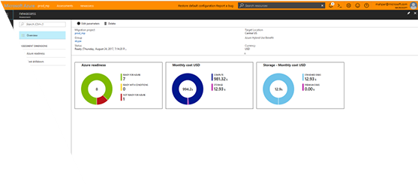
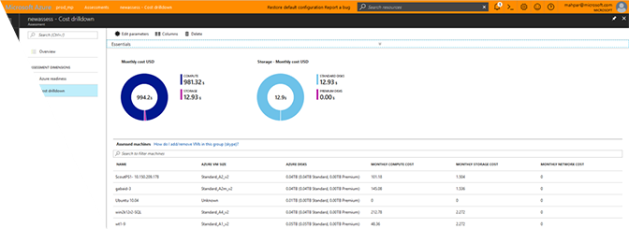
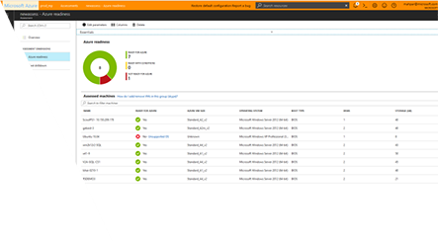
Migrate to App Service: Assess your migration
Assess your ASP.NET website in just a few clicks
Scan the following information on your IIS server and identify readiness for website migration to Azure App Service:
Websites running on the IIS server
Applications and virtual directories configured under each site
Application pools used by the sites and their settings
HTTP and HTTPS bindings used by the sites
Databases defined in web.config using connectionString attribute
http://www.migratetoazure.net/
Notes:
For site to be migrated from Windows Server it must be running on IIS. The minimum supported version of web server is Windows 2003 with IIS 6. This migrates IIS settings that are equivalent and applicable to Azure Web Apps and the websites contents, including the database if selected. The database must be a MS SQL 2005 or greater database. This maintains Virtual Directory and application settings (but will move them all under single application pool. It treats one Website as single entity residing in one application pool.
Further considerations:
Not recommended for very large databases (larger than 500 GB)
Supports Azure AAD authentication using default directory for Azure Web Apps (useful when migrating Windows Authentication based Web Apps)
Can be ran offline on IIS machine and results uploaded later
Can be ran remotely from client machine that has access to IIS servers
Can be ran from SCM machine and migrates multiple sites from, multiple IIS servers inside SCM

Slide 15
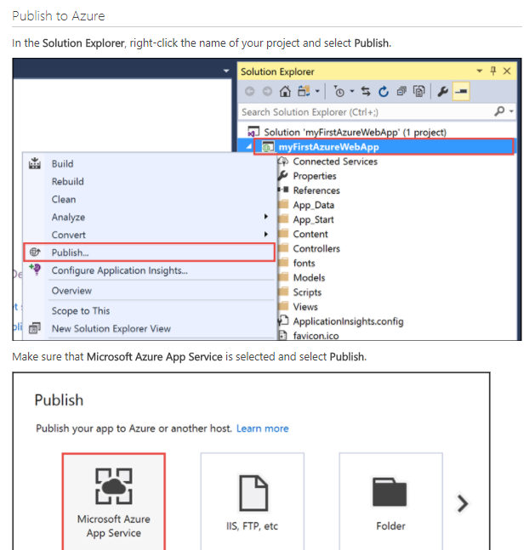
Migrate to App Service: via Visual Studio
Open your existing web app
Run your application
Create an Azure web app
When you’re finished, you will have a resource group that consists of an App Service plan and an Azure web app with your existing app deployed to a web application.
You also have the option of learning how to connect this app to an Azure SQL instance.
aka.ms/ASPmigrate

Slide 16
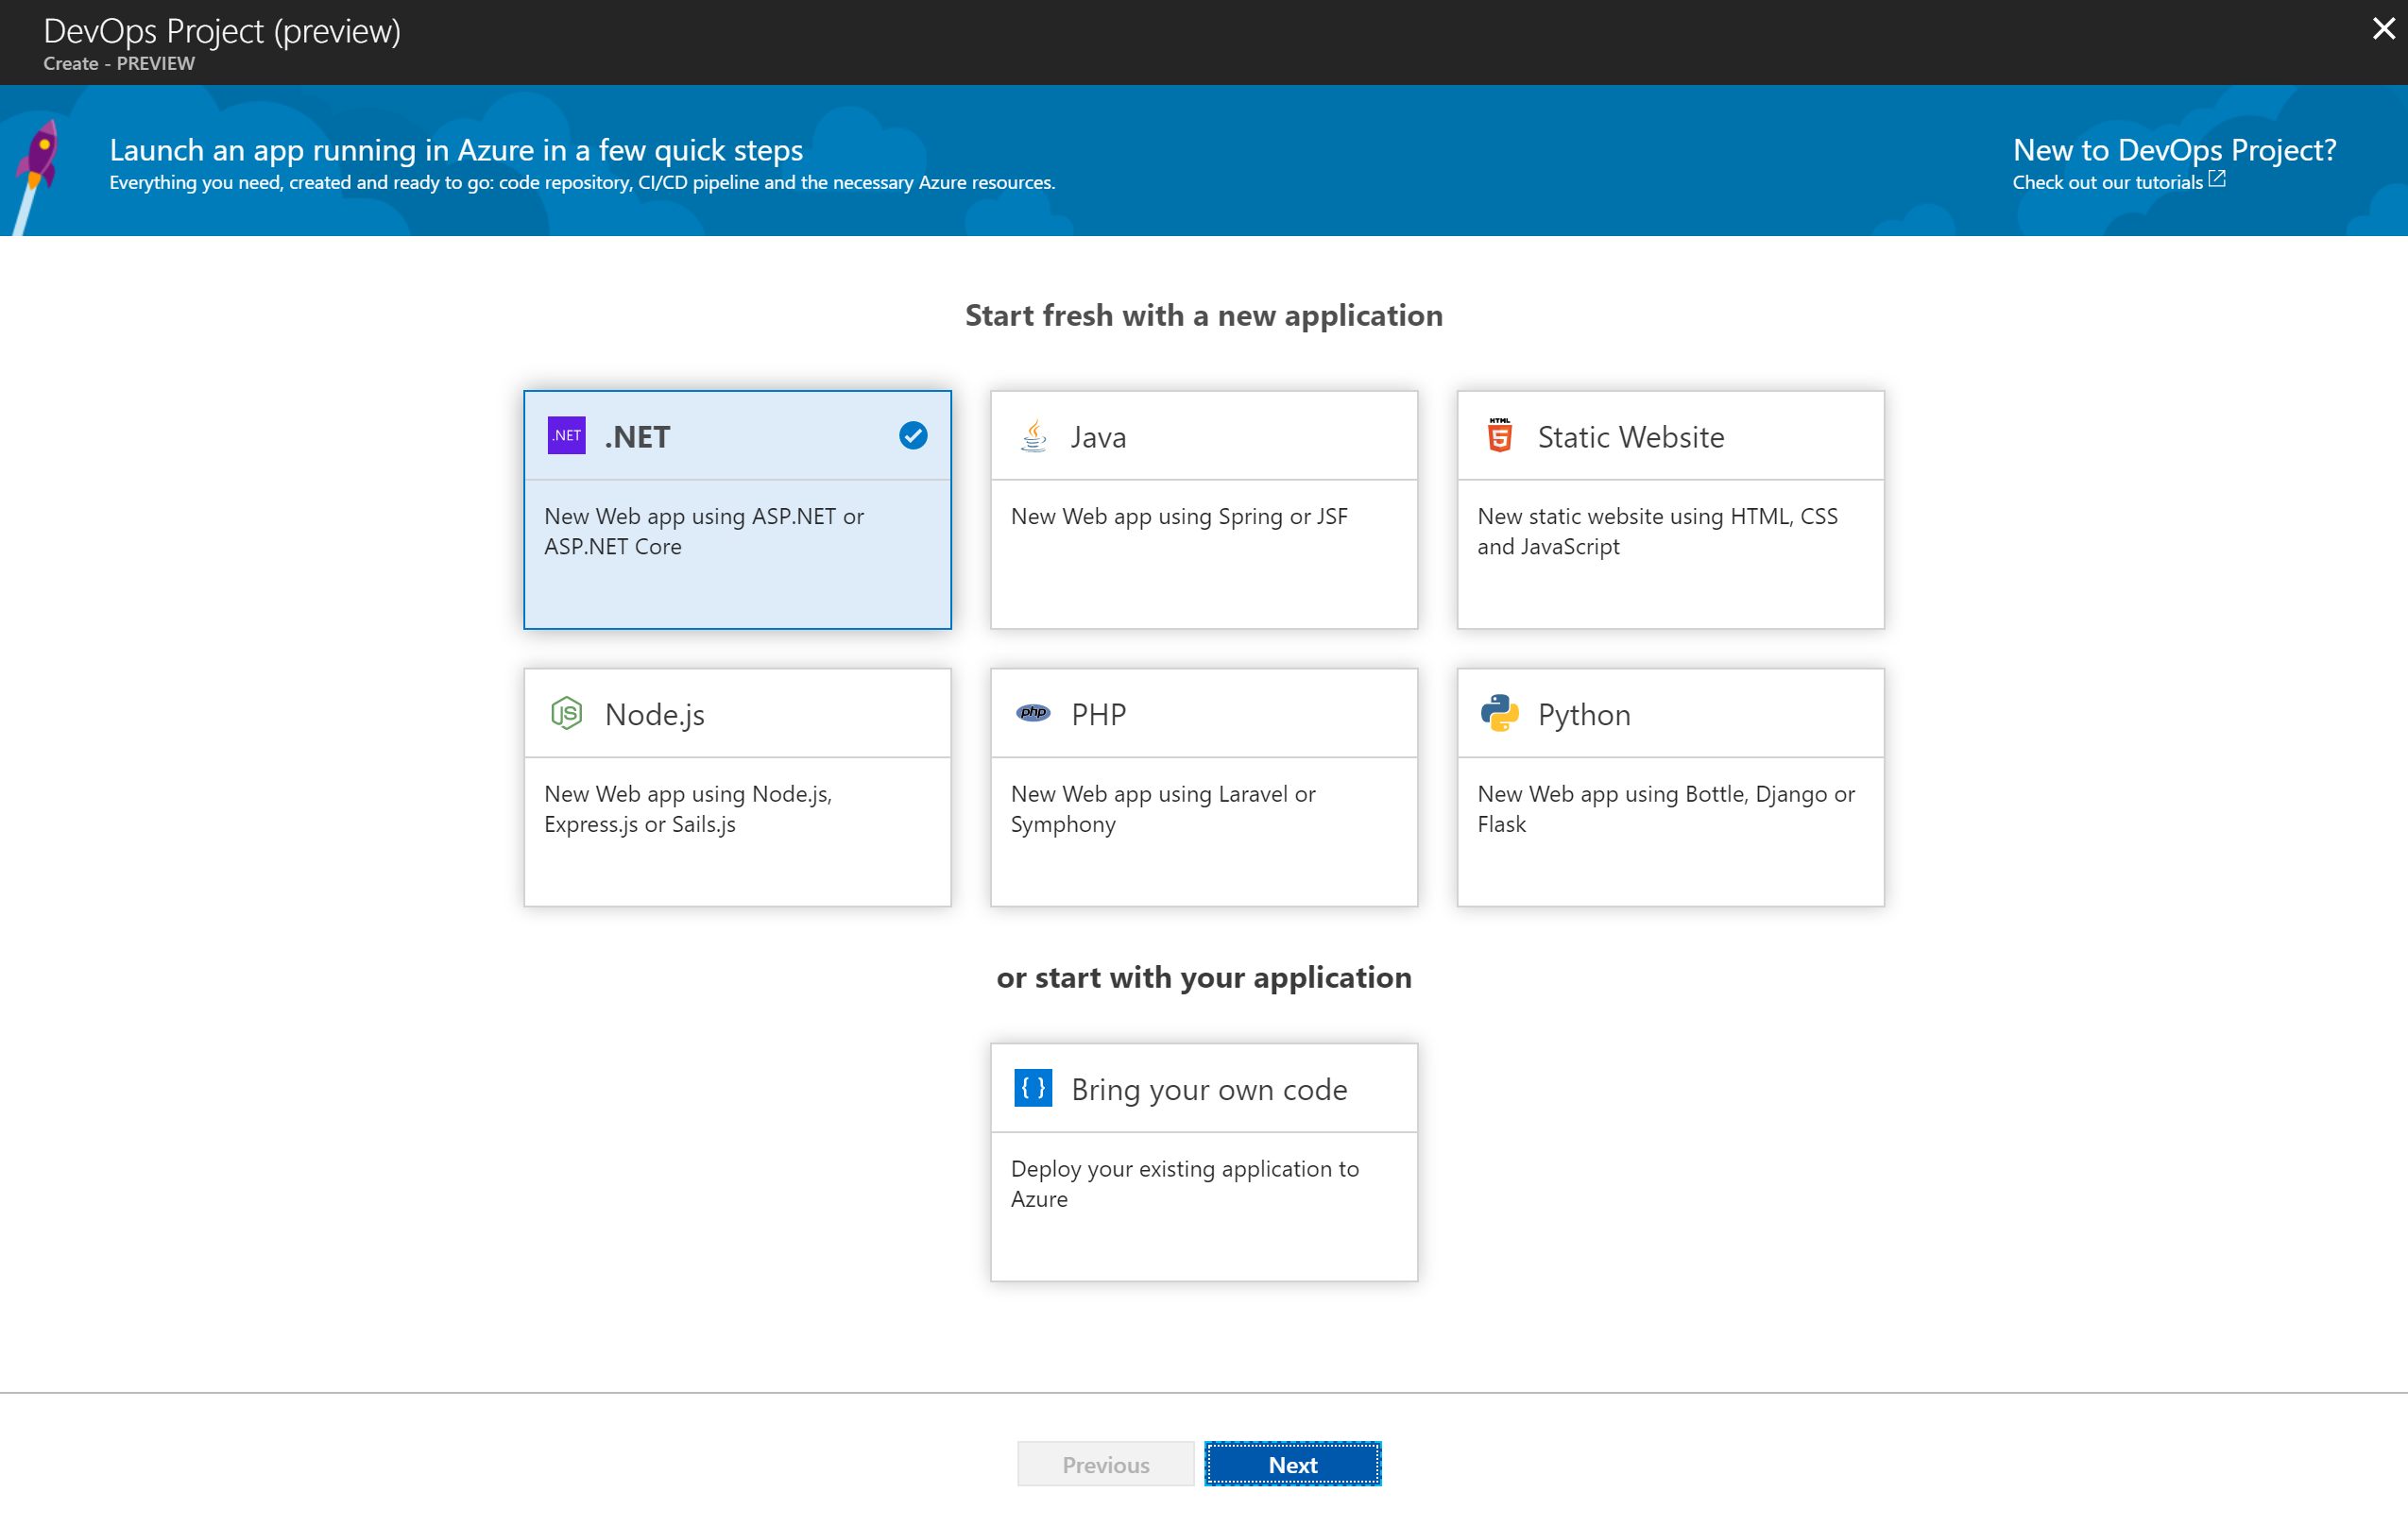
Migrate to App Service: via the Azure Portal
Build any Azure application, on any Azure service, in less than five minutes
Built-in support for popular application frameworks
Automatic full CI/CD pipeline integration
Built-in monitoring with Application Insights
Deployment to the platform of your choice
The Azure DevOps Project presents a simplified experience which creates Azure resources and sets up a continuous integration / continuous delivery (CD) pipeline for your .NET core, ASP.NET, Node.js, Java, Python or PHP applications.
https://azure.microsoft.com/en-us/features/devops-projects/

Slide 17


Data migration tools and services make it easy to migrate your data to the cloud
Assess
Migrate
Microsoft Data Migration Assistant
Rich assessments at scale
Feature recommendations
Schema conversions
aka.ms/SQLMigrate
Azure Database Migration Service
Microsoft and non-Microsoft source support
Built for scale and reliability
Built with enterprise security and privacy
https://azure.microsoft.com/en-us/services/database-migration/
Notes:
The Data Migration Assistant helps with the discovery and assessment stage, then the Migration Service is used to migrate the data, schema, etc. It works with SQL Server as well as Oracle and MySQL.

Slide 18
Challenge 1: Migrate to Azure PaaS
Outcome
Migrate on-premise web application to PaaS services
https://docs.microsoft.com/en-us/azure/app-service/app-service-web-overview
https://www.migratetoazure.net/
https://docs.microsoft.com/en-us/azure/sql-database/
Default Accounts
Admin User Name: sysadmin Admin User Password: Password$123
db Login Name: workshopServiceAcc db User Name: workshopServiceAcc db User Password: P2ssw0rd
Database Name: partsUnlimitedDB

Slide 19
Azure Dev Ops
Formerly known as VSTS

Slide 20




DevOps
1
4
Plan
Monitor + Learn
Development
Production
2
3
Develop + Test
Release

Slide 21
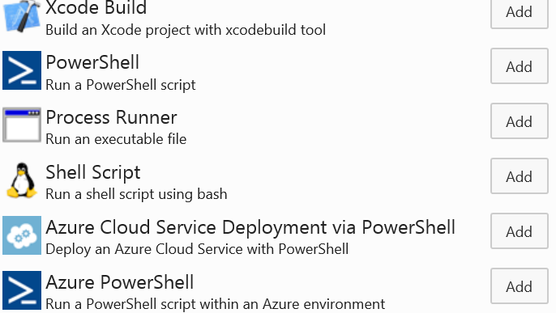
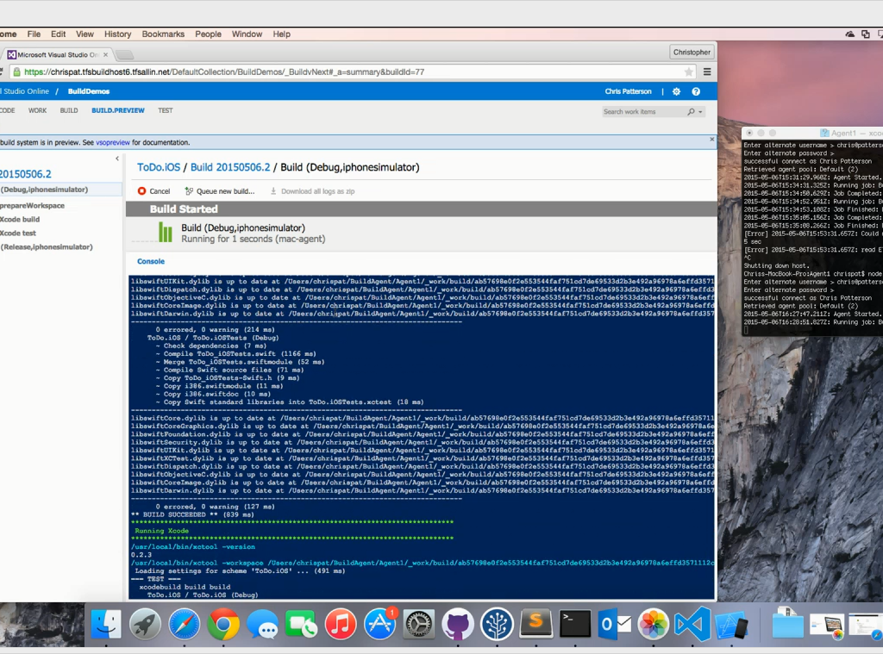
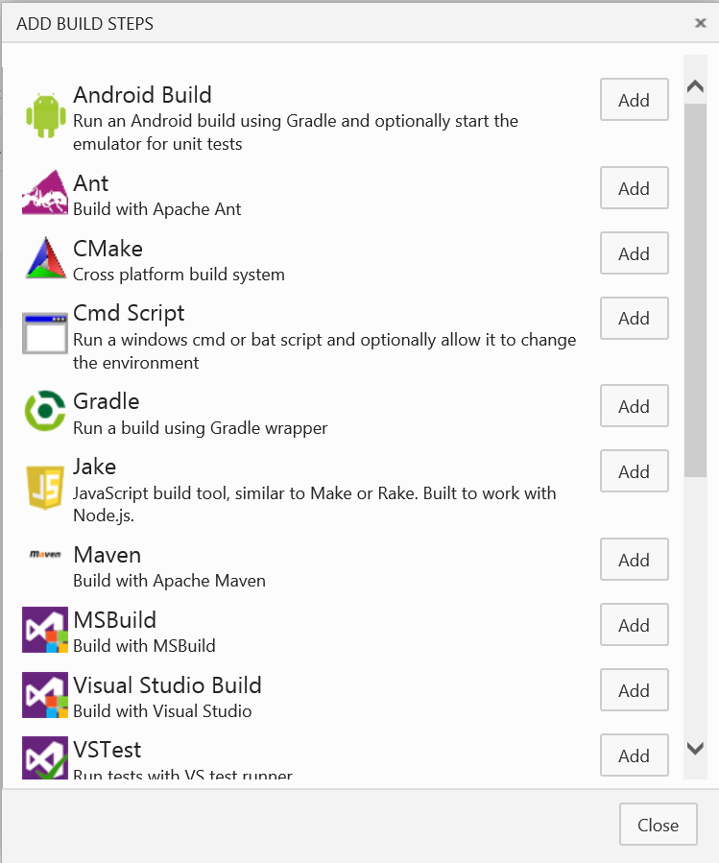
Native cross platform
Notes:
Node.js based xplat agent
OOB support for common xplat technologies
Open Source

Slide 22
Challenge 2: Implementing DevOps Continuous Integration / Continuous Deployment (CI/CD)
Outcome
Create a CI/CD pipeline for the web app which automatically kicks off on check-in’s
https://www.visualstudio.com/team-services/
https://docs.microsoft.com/en-us/azure/virtual-machines/windows/tutorial-vsts-iis-cicd
https://docs.microsoft.com/en-us/vsts/accounts/create-account-msa-or-work-student?view=vsts
Default Accounts
Admin User Name: sysadmin Admin User Password: Password$123
db Login Name: workshopServiceAcc db User Name: workshopServiceAcc db User Password: P2ssw0rd
Database Name: partsUnlimitedDB

Slide 23
Application Insights

Slide 24
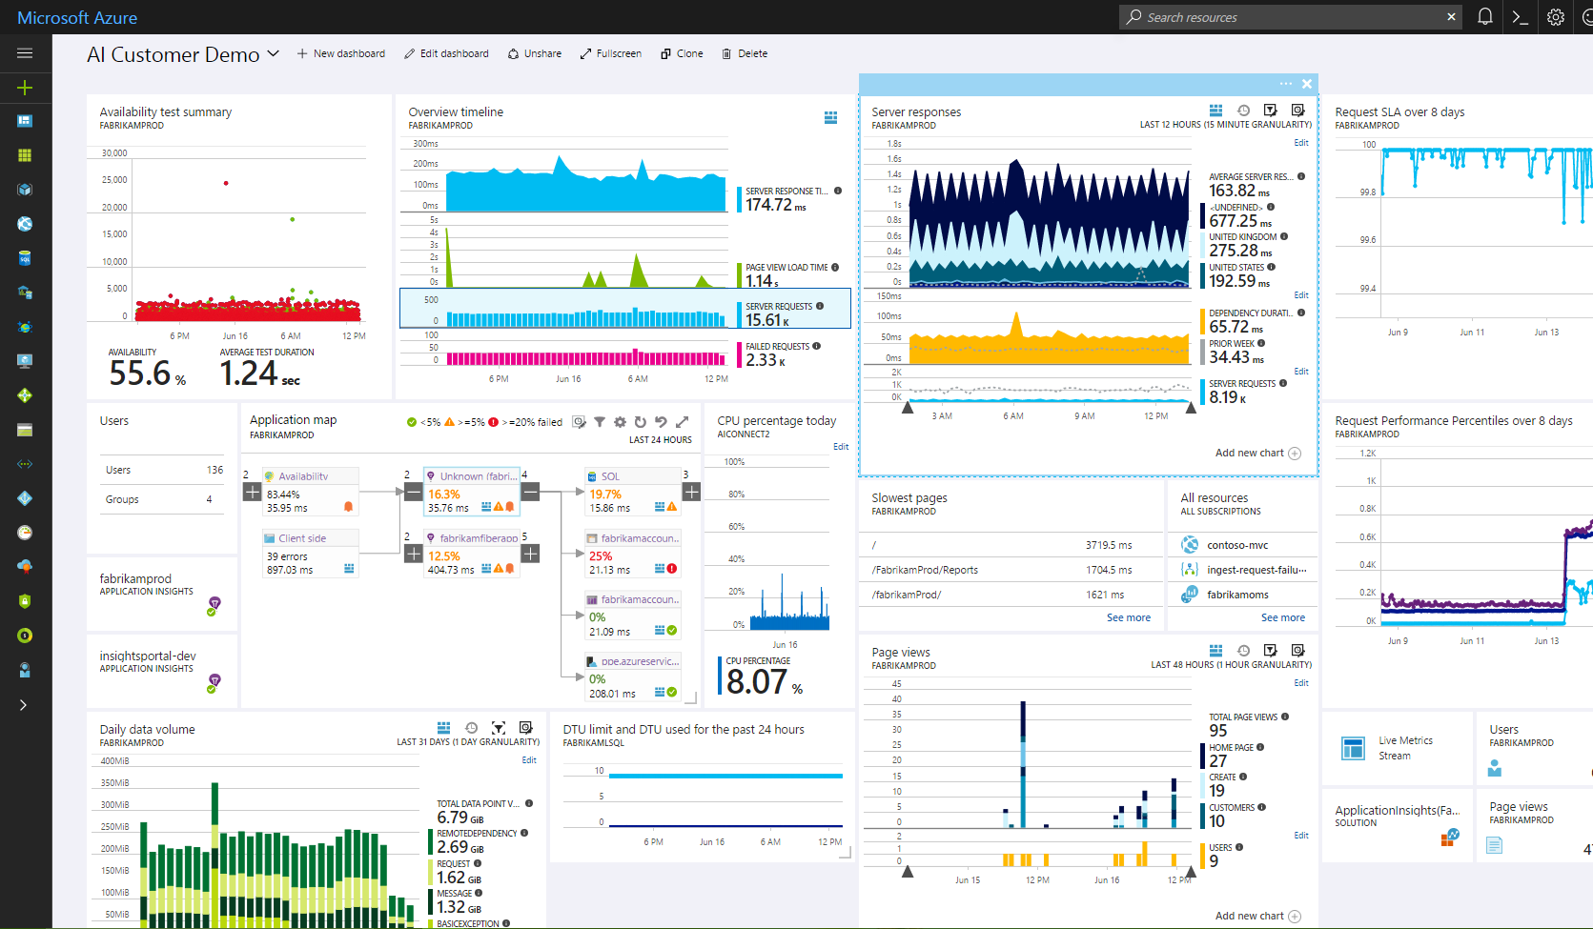
Included in App Service: Application Insights
Powerful insights with a single click
Understand and optimize performance of your apps
Detect and debug errors in your apps
Diagnose problems across your apps, VMs, networks and PaaS services
Show exec dashboards of application SLAs and KPIs
Track usage, engagement and retention of your apps
Determine if there is a security threat

Slide 25
Challenge 3: Detect, Diagnose, Monitor Application Performance with Azure App Insights
Outcome
Identify application issues and performance
https://docs.microsoft.com/en-us/azure/application-insights/app-insights-overview
Default Accounts
Admin User Name: sysadmin Admin User Password: Password$123
db Login Name: workshopServiceAcc db User Name: workshopServiceAcc db User Password: P2ssw0rd
Database Name: partsUnlimitedDB

Slide 26
Challenge 4: Optimize and Protect App
Outcome
Configure App Services to log, backup, & monitor resources
https://docs.microsoft.com/en-us/azure/app-service/web-sites-backup
https://docs.microsoft.com/en-us/azure/architecture/best-practices/auto-scaling
Default Accounts
Admin User Name: sysadmin Admin User Password: Password$123
db Login Name: workshopServiceAcc db User Name: workshopServiceAcc db User Password: P2ssw0rd
Database Name: partsUnlimitedDB

Slide 27
Microsoft Data Services

Slide 28
Microsoft Data Platform Landscape
DATA MANAGEMENT
DATA INSIGHTS
Operational data
ON-PREM CLOUD
Business intelligence
Power BI
SQL Server
Azure SQL Database
Azure Cosmos DB
SQL Server Reporting Services
Data warehousing
Advanced Analytics & AI
SQL Server
Azure SQL Data Warehouse
SQL Server Analysis Services, R Services
Azure Machine Learning
Big data processing
Azure
Stream Analytics
Apache Hadoop
Azure HDInsight
Azure Data Lake
Azure Cognitive Services
Notes:
SQL Server is our mission critical OLTP database with industry-leading TPC-E performance benchmarks. We’ve been recognized by Gartner as a leader in Operational Database Management four years in a row.
Azure SQL Database is the cloud answer to managing your operational data - built on SQL Server, so your existing applications and skills transfer. And as a managed database service, so it can save you time and money in both set-up and administration.
Cosmos DB is our database-as-a-service NoSQL database service designed for modern mobile and web applications.
SQL Server continues to be viable for data warehousing. Today we have companies doing petabyte scale data warehousing in a scale up SMP architecture just with SQL Server.
Azure SQL Data Warehouse is the industry’s first enterprise-class cloud data warehouse that can grow, shrink, and pause in seconds.
Azure Data Lake - Offers data management and analytics at scale to customers, as Azure Data Lake. It is composed of three parts: Azure Data Lake Store, Azure Data Lake Analytics, and HD Insight. Together with these products, you can store big data of any size and type, and analyze it with familiar open-source tools – all while getting a leading, enterprise-class SLA.

Slide 29






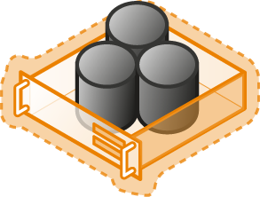
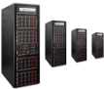

SQL Server Cloud Continuum
On premises
Hybrid Cloud
Off premises
Shared Lower cost
SaaS
PaaS
Azure SQL Data Services
IaaS
Database Services
SQL Server in Azure VM
Virtual
Virtualized Machines
Dedicated Higher cost
SQL Server Private Cloud
Physical
Virtualized Machines+ Appliances
SQL Server
Physical Machines (raw iron)
High Control
Low Control

Slide 30
Azure Relational Database Platform
Power BI
Azure App Services
Azure Data Factory
Azure Analysis Services
Azure Machine Learning
Azure Cognitive Services
Azure Bot Service
Azure SQL Data Warehouse
Azure SQL Database
Azure Database for PostgreSQL
Azure Database for MySQL
Database Services Platform
Intelligent Advisors, tuning, monitoring
Flexible On-demand scaling, resource governance
Trusted HA/DR, backup/restore, security, audit, isolation
Azure compute
Azure storage
Global Azure in 43 regions

Slide 31
Azure SQL Database
Key benefits
Differentiating proof
Learns and adapts
Self-tuning performance with Index Advisor and real-time Threat Detection
Scales on the fly
One click scaling, over 11 performance tiers with zero downtime
Manages 1000s, like one
Tenant isolation and automatic management of compute and storage with Elastic Pools
Works in your environment
Popular platforms & languages, from Python to Ruby to Java to C# to .NET
Secures & protects
Built-in HA and data protection with 99.99% SLA, Geo-Replication, & Point-in-time-Restore

Slide 32
SQL Database Service
A relational database as a service, fully managed by Microsoft.
For cloud-designed apps when near-zero administration and enterprise-grade capabilities are key.
Perfect for cloud architects and developers looking for programmatic, DBA-like functionality.
Elastic scale and performance
Business continuity and data protection
Familiar and self-managed
Predictable performance levels
Programmatic scale-out
Dashboard views of database metrics
Self-service restore
Disaster recovery
Compliance-enabled
Familiar and compatible
Programmatic
Self-managed
Notes:
Objective: This slide is intended to break down the features and services of Azure SQL Database
Talking Points:
Relational Database Service
Azure SQL Database has been designed as a fully managed database solution that is highly compatible with existing management tools, with the added feature of built-in high availability and predictable performance during scale-out. If you decide to use SQL on VMs, which is the IaaS model, then you have the choice of installing any of the many SQL Server images on Azure VM.
Tools and Features
Most of the Transact-SQL features that applications depend on are supported in both Microsoft SQL Server and Azure SQL Database. A partial list of supported features for applications follows:
Data types
Operators
String, arithmetic, logical, and cursor functions
However, Azure SQL Database is designed to isolate features from any dependency on the master database. As a consequence, many server-level activities are inappropriate for SQL Database and are unsupported. This topic details the features that are not fully supported in SQL Database.
SQL Server Management Studio (SSMS) and SQL Server Data Tools (SSDT) in Visual Studio are client tools that run on your computer and allow you to connect to, manage, and develop your database in the cloud. If you're an application developer familiar with Visual Studio or other integrated development environments (IDEs), try using SSDT in Visual Studio. Many database administrators are familiar with SSMS, which can be used with Azure SQL databases. Download the latest version of SSMS and always use the latest release when working with Azure SQL Database. For more information on managing your Azure SQL Databases with SSMS, see Manage SQL Databases using SSMS.
To migrate a compatible SQL Server database, Microsoft provides several migration methods for various scenarios. The method you choose depends upon your tolerance for downtime, the size and complexity of your SQL Server database, and your connectivity to the Microsoft Azure cloud.
Business Continuity
Point-in-time restore is designed to return your database to an earlier point in time. It uses the database backups, incremental backups, and transaction log backups that the service automatically maintain for every user database. This capability is available for all service tiers. You can go back seven days with Basic, 35 days with Standard, and 35 days with Premium. Refer to Recover from human error for details on how to use point-in-time restore.
Active geo-replication is available for for databases in all service tiers. It’s designed for write-intensive applications with the most aggressive recovery requirements. Using active geo-replication, you can create up to four readable secondaries on servers in different regions. You can initiate failover to any of the secondaries in the same way as standard geo-replication. In addition, active geo-replication can be used to support the application upgrade or relocation scenarios, as well as load balancing for read-only workloads.
Refer to Design for business continuity for details on how to configure geo-replication and to Recover from an outage for details of how to failover to the secondary database. Refer to Application upgrade without downtime for details on how to implement the application upgrade without downtime.
Scale
The service is a database as a utility with pay-as-you-grow scaling. This means that you can have more data storage and capacity as your service grows. This in turn means that you can have multitenant solutions and can manage multiple servers that are covered by a service-level agreement.
Pools in Azure SQL Database enable software-as-a-service (SaaS) developers to optimize the price performance for a group of databases within a prescribed budget while delivering performance elasticity for each database. Pools enable the ISV to purchase elastic Database Transaction Units (eDTUs) for a pool shared by multiple databases to accommodate unpredictable periods of usage by individual databases.

Slide 33
Azure SQL Database
The developer’s intelligent cloud database service
Learn and adapt with your app!
Scales on the fly without app downtime!
Build multitenant apps with customer isolation and efficiency!
Work within your environment
so you can focus on building great apps!
Protects and secures
your app data!
Notes:
Objective: This slide is intended to break down the features and services of Azure SQL Database.
Talking Points:
Scales on the fly - Scale performance anytime, anywhere, without app downtime
When demand for your app grows from a handful of devices and customers to millions, SQL Database is the database service that can scale along with you—on the fly and with no app downtime.
Redefines multitenancy - Build multitenant apps with customer isolation and efficiency
If you’re a SaaS app developer writing a multitenant app that services many customers, you often make tradeoffs in customer performance, management, and security. With SQL Database elastic database pools, you no longer have to make that compromise. Creating elastic database pools help you manage and monitor multitenant apps and gain isolation benefits of one customer per database.
Learns and adapts – Learn and adapt dynamically with your app
As your app runs, Azure SQL Database continuously learns your unique app patterns, adaptively tunes your performance, and automatically improves reliability and data protection—freeing you to focus on your app.
Works with your environment - Work within your preferred development environments
Develop your app with the tools and platforms you prefer. Microsoft Azure SQL Database make it easy to connect to SQL Database with a variety of technologies enabling you to focus on developing business logic and apps using tools you are familiar with.
Protects and secures – Help protect and secure your app data
Build security-enhanced apps in the cloud with built-in data protection, high availability, and security features—without implementing custom code. With physical and operational security built in to Azure, SQL Database can help you meet the most stringent regulatory compliances.

Slide 34
Your database on autopilot Built-in admin and data protection
Fully managed activities like maintenance, security, updates, DR and back-ups
No application downtime
Save money, time and worry
Azure SQL Database
Infrastructure maintenance
Security and software patches
Feature updates
Disaster recovery failover
Automatic back-ups
Learns & adapts
Notes:
SQL Database delivers predictable performance at multiple service levels that provides dynamic scalability with no downtime, built-in intelligent optimization, global scalability and availability, and advanced security options — all with near-zero administration. These capabilities allow you to focus on rapid app development and accelerating your time to market, rather than allocating precious time and resources to managing virtual machines and infrastructure.

Slide 35
Threat and anomaly detection Advanced security and compliance
Intelligent threat detection
Built-in behavioral analysis
Real-time alerts
Explorable audit log
Unusual patterns are detected and fixed
Discover, track and remediate vulnerabilities
Real-time threat alerts to admins
SQL Threat Detection
Machine Learning
Anomaly detection
Azure SQL Database
Web app
Real-time alerts to developers
Learns & adapts
External attacker / malicious insider
End user experiencing errors & issues
Notes:
Intelligent Threat Detection - SQL Threat Detection provides a new layer of security, which enables customers to detect and respond to potential threats as they occur by providing security alerts on anomalous activities. Users will receive an alert upon suspicious database activities, potential vulnerabilities, and SQL injection attacks, as well as anomalous database access patterns. SQL Threat Detection alerts provide details of suspicious activity and recommend action on how to investigate and mitigate the threat. Threat Detection makes it simple to address potential threats to the database without the need to be a security expert or manage advanced security monitoring systems.
SQL Vulnerability Assessment (currently in preview) is an easy to configure tool that can discover, track, and remediate potential database vulnerabilities. Use it to proactively improve your database security.

Slide 36
Self-tuning performance Database Advisor and adaptive query processing
Manages indexes, tailored to the specific workload
Tests and validates actions, reverts if impact negative
Runs in full auto-mode, or in recommend/review mode
Continuously monitors query patterns and performance
Tuning algorithms
SQL Database
Database advisor
“My app gets auto-tuned”
“I can do more in less time”
Developer no admin skills
DBA of many databases
Learns & adapts
Notes:
Self-tuning performance. SQL Database provides performance tuning recommendations using SQL Database Advisor, where you can review tuning actions and apply them. Database Advisor helps you to improve the performance of your databases by providing intelligent tuning recommendations that are based on historical usage. Monitoring and tuning actions can also be delegated to SQL Database using an automatic tuning feature. Through automatic index management, SQL Database also identifies indexes that should be added to your database and those that should be removed.
Adaptive query processing. We’ve added the adaptive query processing family of features to SQL Database, including interleaved execution for multi-statement table-valued functions, batch mode memory grant feedback, and batch mode adaptive joins. Each of these adaptive query processing features applies similar “learn and adapt” techniques, helping further address performance issues related to historically intractable query optimization problems.

Slide 37
On-the-fly scale Scale up or down with minimal app downtime
Scale up with one click or a single API call
Accommodate growth and peak workloads
Remove the guess work and pay for what you need, when you need it
New Standard tiers for CPU-intensive workloads*
Basic
5
Standard
10 | 50 | 200* | 800* | 3,000*
Premium
125 | 500 | 1,000 | 1,750 | 4,000
Database transaction units (DTUs)
Scales on the fly
*Higher DTU S4, S6, S7, S9, S12 Standard tiers in preview
Notes:
Adjust performance and scale without downtime
SQL Database offers multiple service tiers to support lightweight to heavyweight database workloads: Basic, Standard, Premium. You can build your first app on a small, single database at a low cost per month and then change its service tier manually or programmatically at any time to meet the needs of your solution. You can adjust performance without downtime to your app or to your customers. Dynamic scalability enables your database to transparently respond to rapidly changing resource requirements and enables you to only pay for the resources that you need when you need them.
New Standard performance tiers (in preview) provide price savings opportunities for CPU intensive workloads that do not demand the kind of high IO performance provided by the Premium tier.
For IO intensive workloads, the Premium tier continues to provide lower latency per IO and an order of magnitude more IOPS per DTU than in the Standard tier.
For the latest performance tiers and pricing: https://azure.microsoft.com/en-us/pricing/details/sql-database/

Slide 38
Resource and tenant administration Elastic database pools
Gain automatic management and administration of compute and storage across unlimited databases
Cap your spending and maximize utilization
Scale customers in multi-tenant apps or manage LOB databases effectively
Gain database-level data and tenant isolation
Customer 1
Customer 2
Customer N
Elastic Database Pools
Basic | Standard | Premium
Min/max DTUs per second per DB
Redefines multi-tenancy
125 | 200 | 400 | 1,000 | 1,200
Notes:
Elastic pools to maximize resource utilization
For many businesses and applications, being able to create single databases and dial performance up or down on demand is enough, especially if usage patterns are relatively predictable. But if you have unpredictable usage patterns, it can make it hard to manage costs and your business model. Elastic pools are designed to solve this problem. The concept is simple: you allocate performance resources to a pool rather than an individual database, and pay for the collective performance resources of the pool rather than for single database performance.
With elastic pools, you don’t need to focus on dialing database performance up and down as demand for resources fluctuates. The pooled databases consume the performance resources of the elastic pool as needed. Pooled databases consume but don’t exceed the limits of the pool, so your cost remains predictable even if individual database usage doesn’t. What’s more, you can add and remove databases to the pool, scaling your app from a handful of databases to thousands, all within a budget that you control. You can also control the minimum and maximum resources available to databases in the pool to ensure that no database in the pool uses all the pool resources and that every pooled database has a guaranteed minimum amount of resources.
Extensive monitoring and alerting capabilities
You can compare the relative performance of single databases and elastic pools by using built-in performance monitoring and alerting tools, combined with the performance ratings based on Database Transaction Units (DTUs) for single databases and elastic DTUs (eDTUs) for elastic pools. Using these tools, you can quickly assess the impact of scaling up or down based on your current or project performance needs. See SQL Database options and performance: Understand what's available in each service tier for details.
Additionally, SQL Database can emit metrics and diagnostic logs for easier monitoring. You can configure SQL Database to store resource usage, workers and sessions, and connectivity into one of these Azure resources:
Azure Storage: For archiving vast amounts of telemetry for a small price
Azure Event Hub: For integrating SQL Database telemetry with your custom monitoring solution or hot pipelines
Azure Log Analytics: For built-in monitoring solution with reporting, alerting, and mitigating capabilities

Slide 39

Mission critical availability High availability at global scale
Industry-leading 99.99% availability SLA
Automatic backups
Point in time restore with up to 35 days retention
Active geo-replication and failover groups support RPO <5s
Up to 4 readable secondaries
Secures & protects
Notes:
SQL Database provides built-in business continuity and global scalability features, including:
Automatic backups: SQL Database automatically performs full, differential, and transaction log backups.
Point-in-time restores: SQL Database supports recovery to any point in time within the automatic backup retention period, up to 35 days.
Active geo-replication: SQL Database allows you to configure up to four readable secondary databases in either the same or globally distributed Azure data centers. For example, if you have a SaaS application with a catalog database that has a high volume of concurrent read-only transactions, use active geo-replication to enable global read scale and remove bottlenecks on the primary that are due to read workloads.
Failover groups: SQL Database allows you to enable high availability and load balancing at global scale, including transparent geo-replication and failover of large sets of databases and elastic pools. Failover groups and active geo-replication enables creation of globally distributed SaaS applications with minimal administration overhead leaving all the complex monitoring, routing, and failover orchestration to SQL Database.

Slide 40
Challenge 5: Optimize & Protect Data
Outcome
Enable logging, monitoring, scaling of database.
https://docs.microsoft.com/en-us/azure/sql-database/
https://docs.microsoft.com/en-us/sql/relational-databases/security/encryption/transparent-data-encryption-azure-sql?view=azuresqldb-current
https://docs.microsoft.com/en-us/azure/sql-database/sql-advanced-threat-protection
https://docs.microsoft.com/en-us/azure/sql-database/sql-database-what-is-a-dtu
Default Accounts
Admin User Name: sysadmin Admin User Password: Password$123
db Login Name: workshopServiceAcc db User Name: workshopServiceAcc db User Password: P2ssw0rd
Database Name: partsUnlimitedDB

Slide 41
Azure Content Delivery Network (CDN)

Slide 42
Why is Azure CDN Important?
Easy Enablement & Integration
No Development / No Code Required
Customer Self-Service Activation
Enhances User Experience
Improves Scalability of Any Internet Facing Service
Automatic Scaling, Increased Usage Increased Consumption

Slide 43
Why Azure alone might not be enough
Internet does not optimize for performance
Azure Data Centers globally rely on the Internet to deliver content to edge devices
Without a CDN, delivery of content suffers yielding poor customer experience
Routing complications, traffic and congestion, and security flaws
Explosion of devices, network types
Richer, more sophisticated content
Evolving protocols and formats
Attacks, increasing in scale, sophistication

Slide 44
Why should you care about CDN ?
57% Abandon a website that takes more than 3 secs to load(1)
87% Stop Watching Video if video takes more than 7 secs to buffer (2)
1% Drop in revenue for 100ms slowdown for ecommerce site
Google
Add’l page load of 500 ms = 20% impact on ad rev
Microsoft Bing
Add’l page load of 2 sec = Reduction of 2.5% of clicks/requests
Amazon
Add’l page load of 100ms = 1% impact on revenue
Yahoo
Improvement of 400 ms page load = 9% traffic increase
Mozilla
2.2 seconds less of download time for Firefox = 60 millions additional downloads!
Notes:
Akamai
Cedexis

Slide 45




CDN accelerates any web content
Static—fixed objects that aren’t capable of action or change
Dynamic—actions that take place in real time, rather than in advance
Code
SaaS
Downloads
Web applications
Media
Notes:
A CDN can accelerate any type of content, whether it is static content or dynamic. Of course, dynamic content is a bit harder to cache as it is typically unique per user. However, it must be understood that a large portion of any site (images, javascript, html and css) is still static content and typically accounts for more than 80%.
CDN is typically required for media applications, as those represents the largest files that can be encountered. And to be crystal clear, it also enhances the experience with live content over the internet, as users typically do not request the same fragments of the video at the same time, as they tune to the channels at different times.

Slide 46
Challenge 6: Optimize web application performance implementing CDN
Outcome
Web Application has a CDN implemented to improve performance
https://azure.microsoft.com/en-us/services/cdn/
https://docs.microsoft.com/en-us/azure/cdn/cdn-overview
https://docs.microsoft.com/en-us/azure/cdn/cdn-create-new-endpoint
Default Accounts
Admin User Name: sysadmin Admin User Password: Password$123
db Login Name: workshopServiceAcc db User Name: workshopServiceAcc db User Password: P2ssw0rd
Database Name: partsUnlimitedDB

Slide 47
Challenge 7: Optimize web application performance implementing CDN for static assets
Outcome
Web Application has a CDN implemented for static files to improve performance
https://azure.microsoft.com/en-us/services/cdn/
https://docs.microsoft.com/en-us/azure/cdn/cdn-overview
https://docs.microsoft.com/en-us/azure/cdn/cdn-create-new-endpoint
Default Accounts
Admin User Name: sysadmin Admin User Password: Password$123
db Login Name: workshopServiceAcc db User Name: workshopServiceAcc db User Password: P2ssw0rd
Database Name: partsUnlimitedDB

Slide 48
Caching – Redis Cache

Slide 49

What is Redis?
It stands for REmote DIctionary Server
Extremely fast and versatile
Ability to store complex Data Structure(s)
Blurring boundaries where caching ends and where NoSQL DB begins
Rapidly growing (Craiglist, Twitter, Instagram)
Open Source, awesome community

Slide 50
Redis features
Low latency, high throughput key-value store
Per Key expiry, choice of eviction policies.
Atomic operations on data types
Strings, hashes, lists, sets, sorted sets, and bitmaps.
Transactions
Publisher-Subscriber pattern
LUA scripting
Pipelining
Client libraries in multiple languages

Slide 51
Why Redis ?
In-Memory makes it fast
Scale-Out
Dynamic Schema
Reduce expensive database access
Flexible with TTL and LRU options

Slide 52
Redis Runs In-Memory Task: Read 10,000 database records concurrently from a web app
Disk | RAM
300 random reads per second 3 to 7 ms per read 30 sec to 70 sec total | 36,000,000 random reads per second 20 to 60 ns per read 0.2 ms to 0.6 ms total 150,000x faster than HD and 500x faster than SSD

Slide 53
How Does It Work
Asynchronous Single Threaded Event Loop
Its just a basic while(true) loop
Redis handles all operations in this loop
Stores all data In-memory
Optional backup\persistence to disk
Redis is single-threaded
Uses single core
Exception - append-only journal – written using background thread

Slide 54
Challenge 8: Increase Performance/Load with Redis Cache
Outcome
Load has been reduced and site responses quicker.
https://docs.microsoft.com/en-us/azure/redis-cache/cache-dotnet-how-to-use-azure-redis-cache
https://docs.microsoft.com/en-us/azure/architecture/antipatterns/no-caching/
Default Accounts
Admin User Name: sysadmin Admin User Password: Password$123
db Login Name: workshopServiceAcc db User Name: workshopServiceAcc db User Password: P2ssw0rd
Database Name: partsUnlimitedDB

Slide 55
What is Azure Search?

Slide 57
Azure Search Search-as-a-Service
Management Free Keyword search Faceting Geospatial support Multi-Language Support Suggestions/auto-complete Customizable scoring models Proximity Search Synonyms etc.

Slide 58
Pre-Built AI
To develop applications that understand us
Vision
Speech
Language
Conversation
Bing Search
Knowledge
Azure Cognitive Services
Powerful prebuilt AI models exposed as API services
Process images, video, speech, language and more
Simple REST APIs with .NET, Java, Python, Node SDKs
Easily customize your own state-of-the-art AI models
Train in the cloud and deploy anywhere

Slide 59



Cognitive Search Architecture
IEnricher
IEnricher
Cognitive Skill
Document Cracking
Skillset:
Extensible enrichment
pipeline
Indexing for Search
Customer Data
Annotated Documents
Search Index
.pdf
.doc
.jpeg
…
Built-in Cognitive Skills OCR, Key Phrase Extraction, People Names, Company Names,
Sentiment Analyzer, Computer Vision,
etc.
Third Party Enrichers Custom classification models, Custom entity extraction,
etc.
Azure Machine Learning

Slide 60

Built-in Skills in multiple languages
Natural Language Processing
Key Phrase Extraction Sentiment Analysis Organization Entity Extraction Location Entity Extraction Persons Entity Extraction Language Detection
Image Processing
Face Detection Tag Extraction Celebrity Recognition Landmark Detection Handwriting Recognition (Preview) Printed Text Recognition
Utilities
Complex Type Shaping Text Merging Text Splitting

Slide 61
Challenge 9: Improve Quality and Performance of Search
Outcome
Search is improved and able to scale and pick up new words.
https://docs.microsoft.com/en-us/azure/search/
Default Accounts
Admin User Name: sysadmin Admin User Password: Password$123
db Login Name: workshopServiceAcc db User Name: workshopServiceAcc db User Password: P2ssw0rd
Database Name: partsUnlimitedDB

Slide 62
Serverless Patterns with Azure Functions

Slide 63
What is “Serverless”
Abstraction of servers
Event-driven scale
Sub-second billing
Notes:
Abstraction of servers, infrastructure and configuration of operating system
Event-driven scale
Sub-second billing
Stateless

Slide 64
How is it different
Mono-lithic application
Inside client app
Complex framework
Loosely coupled components
Outside client app
Micro-functionality
Notes:
Mono-lithic application -> loosely coupled components
Events happening async outside client application
Build/use micro-functionality to react to a single event

Slide 65
Benefits of “Serverless”
Quick start
Managed for you
Focus on Business Logic
Notes:
“Pinnacle of PaaS compute”
Not just hardware “servers”, but software servers are also managed for you
Focus on business logic, not solving technical problems not core to business
Lower effort to get started makes it easier to experiment (bots, etc.)

Slide 66
Signs that a serverless pattern might be useful for a given scenario
Stateless → Scale
Too complicated to deploy a traditional backend
Workload is sporadic (very low & high scale)
(Human) Operational costs need to stay low
Lots of different services involved

Slide 67
Applications
Example: Timer based processing
Eve
r
y 15 minutes
Find and clean invalid data
Clean table

Slide 68
Applications
Example: Azure service event processing
CSV
File added to
T
ransfo
r
m CSV to data
r
ows
P
ower BI
Blob Storage
Cha
r
t graphic

Slide 69
Applications
Example: SaaS event processing
Excel file saved
Mic
r
os
o
f
t Graph API analyzes content
C
r
eates new sheets
to OneDrive
with cha
r
ts

Slide 70
Applications
Example: Serverless Web Applications architectures
Loaded web page
C
r
eate ad based on user p
r
o
file
Completed page
calls
W
ebHook

Slide 71
Async background processing
Example: Serverless Mobile back ends
Photo taken and
Sto
r
es in blob storage
P
r
W
ebHook called
oduces scaled images

Slide 72
Applications
Example: Real-time stream processing
Millions
o
f devices feed
T
ransfo
r
m to structu
r
ed data
Sto
r
e data in
into St
r
eam Analytics
SQL Online

Slide 73
Applications
Example: Real-time bot messaging
...
?
Co
r
tana Analytics answe
r
Message sent
s questions
Chatbot sends
to Chatbot
r
esponse

Slide 74


Integration
Example: Invoice Processing
API Management
Logic App
Function
Post new invoice
Convert to JSON
Grab raw file
Store record
API layer
Fetch Invoice
Notes:
Chris

Slide 75
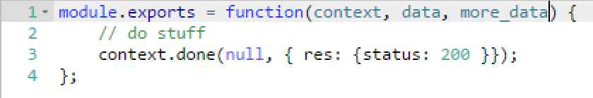
Functions programming concepts
Trigger
Input
Code
Output

Slide 76







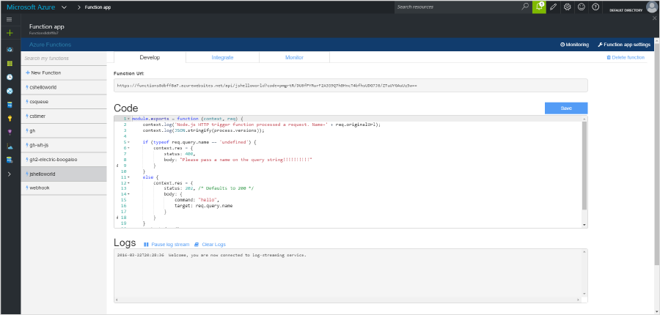





1) Trigger
2) Input Binding
3) Develop
4) Execute
5) Output Binding
Web
Hooks
App Services
Hosting Plans
Azure Services
Azure Services
Azure Services
7) Develop Locally
6) Monitor and Improve
Notes:
This is the whole (top level) Dev Ops story where Dev build wounderful apps, using CI they mange their code, builds, and releases. Connecting to a repository, they can deploy to Azure Websites, build in the cloud, deploy to a slot to test and validate, swap into production, deployed across the globe as needed, monitor and get feedback, on which devs can make updates. Rinse and repeat

Slide 77

Get started and reach out!
Try Functions – https://functions.azure.com
Try App Service – https://tryappservice.azure.com

Slide 78
Challenge 10: Accelerate development & take advantage of serverless
Outcome
Moved product details over to microservices & serverless
https://docs.microsoft.com/en-us/azure/azure-functions/
https://docs.microsoft.com/en-us/azure/azure-functions/functions-create-first-azure-function
Default Accounts
Admin User Name: sysadmin Admin User Password: Password$123
db Login Name: workshopServiceAcc db User Name: workshopServiceAcc db User Password: P2ssw0rd
Database Name: partsUnlimitedDB

Slide 79
What is API Management?

Slide 80








APIs and API economy
IoT
Mobile
“Application programming interfaces (APIs) have been elevated from a development technique to a business model driver and boardroom consideration.
An organization’s core assets can be reused, shared, and monetized through APIs that can extend the reach of existing services or provide new revenue streams.
APIs should be managed like a product - one built on top of a potentially complex technical footprint that includes legacy and third-party systems and data.
From the “API Economy”
by George Collins and David Sisk
Deloitte Consulting LLP, 2015
2-speed IT
Cloud
Analytics
Microservices

Slide 81

Azure API Management
API consumers
AZURE API MANAGEMENT
Abstraction
decouple
modernize
optimize
...
Middleware
secure
protect
cache
...
Monitoring
usage
health
monetization
...
Developer
discover
document
on-board
...
APIs on Azure
Azure APIs
On-prem APIs
3rd party APIs

Slide 82



AZURE API
MANAGEMENT
APP DEVELOPERS
Developer Portal
DIRECT or
VPN
BACKEND
APIs
APPS
Gateway
Hosted anywhere.
Developed using any technology.
API PUBLISHERS
Publisher portal

Slide 83
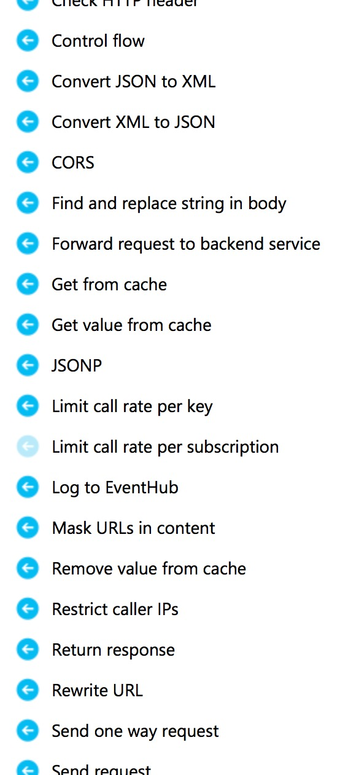
Policies and expressions
Policies
Encapsulate common API management capabilities
Mutate request context or change API behavior
Can be set in the inbound and outbound directions
Have global, product, API or operation scope
Expressions
C# “snippets” embedded in policies
Have read-only access to the request context
Can use whitelisted .NET types only
Are used to dynamically configure policies

Slide 84



Microsoft Enterprise Integration
API Management
Create API frontends for backends in the cloud and on-premises Protect, monitor and monetize the APIs Onboard external and internal app developers
Logic Apps
Connect to SaaS applications and custom APIs Serverless flows, auto scaling, fully managed. Leverage Azure Services
BizTalk Server
Automate mission critical processes Integrate on-premises LOB to SaaS apps Support for new Microsoft Platforms
Service Bus
Cloud-based messaging service Connect to the cloud Secure and predictable message delivery

Slide 85
Challenge 11: Monetize/Monitor data/services
Outcome
Able to manage/monitor API through API Management
https://docs.microsoft.com/en-us/azure/api-management/
Default Accounts
Admin User Name: sysadmin Admin User Password: Password$123
db Login Name: workshopServiceAcc db User Name: workshopServiceAcc db User Password: P2ssw0rd
Database Name: partsUnlimitedDB

